Slide 1

Framework for
Marketing
Eugene W. Anderson
Professor of Marketing and Associate Dean for Degree Programs
* copyright 2003 by Eugene W. Anderson. All rights reserved.

Slide 2
Framework for Marketing
Situation Analysis
Customers • Competitors • Company
Analyze the Situation
 Assess customer needs & behaviors, company
capabilities, competitor positions (3C’s)
 ID key problems & opportunities (SWOT)
Marketing Strategy
Segmentation • Targeting • Positioning
Formulate Marketing Strategy (STP)
 Set marketing objectives
 Select target segment(s)
 Select competitive position
Marketing Mix
Product • Promotion • Place • Price
Determine Marketing Mix Program (4P’s)
 Select product, promotion, place, and price
 Evaluate alternatives
Market Monitoring
Market-Based Metrics
Monitor Performance and Adapt
 Select internal and market-based metrics
 Analyze, disseminate, & respond

Slide 3

Situation Analysis
Goal: To provide a strong foundation for making better marketing decisions
Basic Premise: ‘Ready-Aim-Fire’ is more likely to achieve desired results than ‘Fire-Aim-Ready’
Also known as “the 3C’s”
  Customers – What are target customers’ needs?
  Company – What special capabilities do we possess for meeting those needs?
  Competitors – Who else is competing to meet those needs?

Slide 4
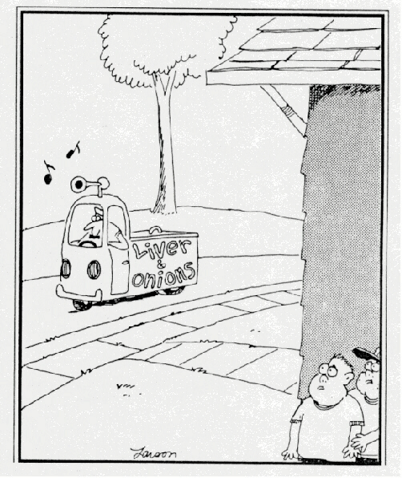
Customers
Ultimately, it is the customer that sets the rules of the game
You will need to understand the rules to win
  How decisions are made
  Who is involved
  What information is used
  The trade-offs they are willing to make
  Where & when they are ready to buy
  How the product or service is used
  Etc

Slide 5
Customer Analysis
Market Segmentation
  What segments can be identified?
  What is their size, growth & potential?
Decision Making Unit (DMU)
  Who is involved?
  Who has power? Who has stake?
  How great is bargaining power?
Decision Making Process (DMP)
  How/when/where do buyers search, decide, purchase, transport, store, use, maintain, dispose, re-buy, etc
  What drives perceived value?
  What are customer acquisition & retention characteristics?
 | Segment
 | 1 | 2 | 3 | 4
Who?
What?
Where?
When?
How?
Why?

Slide 6
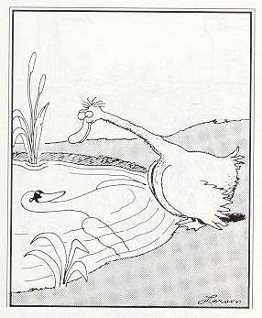
Company
What’s special about us (really)?
Are we doing the right things?
Are we doing things right?

Slide 7
Company Analysis
How favorable is our position?
  Performance
  Advantage
  Resources
  Tactics
  Strategy
Is our position sustainable?
COMPANY
Our best marketing strategy,
given our capabilities and
marketplace dynamics
POSITION
Creates sustainable
competitive advantage in
attractive target segments
RESULTS
Achieves superior results
and increases market value

Slide 8
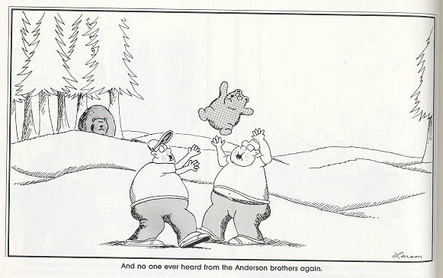
Context
What risks might environment factors and change present?

Slide 9
Context Analysis
How favorable is the PEST?
  PEST = Political, Economic, Social, & Technological Macroenvironment
How favorable are the relevant competitive forces?
  Bargaining power of suppliers, buyers, collaborators & investors
  Degree of competitive rivalry
What are the trends and most likely future scenarios?
What are the implications for anticipated returns?
Political
Legal
Suppliers
Economic
Ecological
Collaborators
Competitors
Customers
Company
Complements
Value
Potential
Entrants
Capital
Social
Demographic
Technological
*

Slide 10
Competitors
For long-run success, marketing strategy and tactics must take into account likely competitive moves & counter-moves
  What we do affects what they do which affects what we do and so on
  So our opening move needs to take all players’ subsequent moves into account
Our
Opening
Move
Our
Next
Move
“Long-Run”
Positions
Their
Best
Response
Their
Best
Response

Slide 11
Competitor Analysis
Who are our competitors?
  Direct, indirect, and potential
What are their positions?
  Strategy
  Tactics
  Resources
  Implementation
  Performance
What are they likely to do?
  Anticipated future moves?
  Expected reaction patterns?
Identify
Competition
Assess
Competition
Anticipate
Competition
Own
Behavior

Slide 12
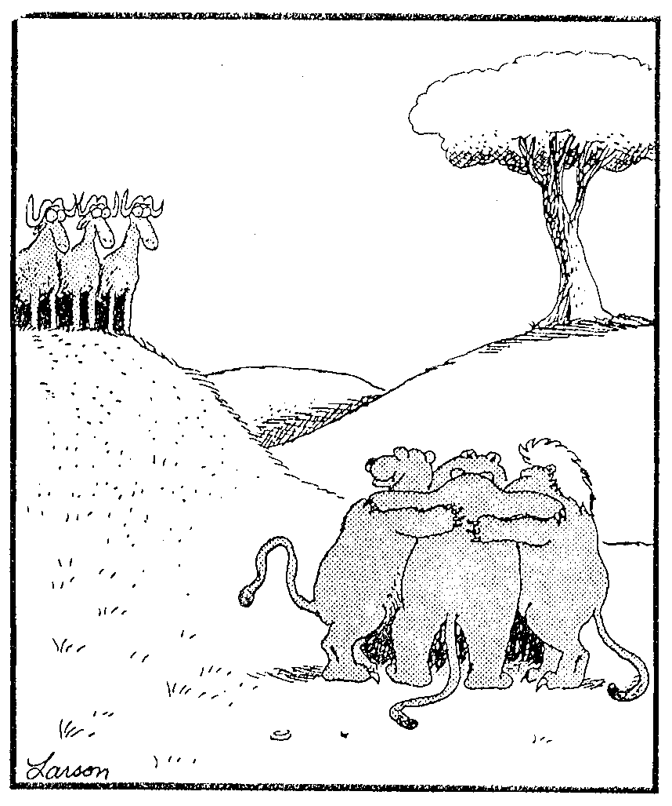
Collaborators
Who has capabilities that we need?
Are our goals compatible?
What level of commitment is required?
What structure & systems are needed?
What do we need to know/learn?

Slide 13
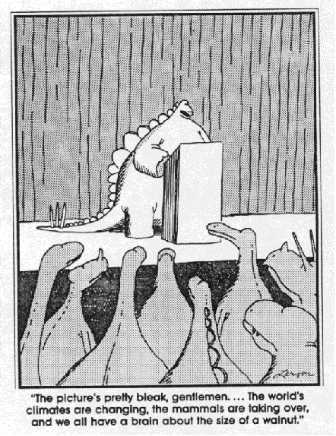
SWOT Analysis
Goal: To distill the Situation Analysis down to a few ‘material’ issues that must be addressed in developing strategy and tactics
Identify the key problems & opportunities
  Internal ‘strengths and weaknesses’ (SW)
  External ‘opportunities and threats’ (OT)
Prioritize factors identified
  Is the situation favorable or not? Why?

Slide 14
SWOT Analysis
Strengths
Opportunities
Importance
Favorability
Importance
Favorability
Strength 1
Opp’y 1
Strength 2
Opp’y 2
Strength 3
Opp’y 3
Overall
WAVG
Overall
WAVG
Weaknesses
Threats
Importance
Favorability
Importance
Favorability
Weakness 1
Threat 1
Weakness 2
Threat 2
Weakness 3
Threat 3
Overall
WAVG
Overall
WAVG
Overall Favorability = Sum of Weighted Averages (WAVG) For Each Element

Slide 15
The Marketing Plan
Executive Summary
Situation Analysis (3C’s)
  Customer Analysis
  Competitor Analysis
  Company Analysis
SWOT Analysis
  Internal: Strengths and Weaknesses
  External: Opportunities and Threats
Marketing Objectives
  Corporate
  Business Unit
  Product
Marketing Strategy (STP)
  Segmentation
  Targeting
  Positioning
Marketing Mix Program (4P’s)
  Product
  Place
  Promotion
  Price
Marketing Metrics
  Internal and Market-Based Metrics
Financial Documents
  Budget, Pro-Forma, Etc

Slide 16
Marketing & Performance
From a systems perspective, the purpose of the marketing planning process is to adaptively seek to optimize the following ‘machine’
Product
Segmentation
Acquisition
Place
Financial
Targeting
Satisfaction
Promotion
Organizational
Positioning
Retention
Price
Marketing
Strategy
Marketing
Mix
Customer
Response
Goals &
Objectives

Slide 17
Summary
There is a logical process of marketing that works
  The 3C’s – STP – 4P’s framework provides us with a ‘blueprint’ or ‘road map’ for developing successful marketing plans
Although much of marketing often seems to be common sense, it is also not human nature
  Putting yourself in the other person’s shoes
  Knowing your self
  Thinking more than one step ahead
  Being able to see the forest for the trees

